Slide 1
C++ is Fun – Part Seven at Turbine/Warner Bros.!
Russell Hanson

Slide 2

Homework #3 Exercises (pick 2)
1)
#include "stdafx.h"
#include <iostream>
using namespace std;
float myfunction (float ns, float sp, float sc, float pp, float pc) {
return (((ns*sp)-sc)-((ns*pp)+pc));
}
int _tmain(int argc, _TCHAR* argv[]){
float ns=100, sp=45.95, sc=8.00, pp=6.95, pc=8.00;
cout << "Enter Number of Shares, Sale Price Per Share, Sale Commission, Purchase Price per Share, Purchase Commission Paid,\n";
cout << "separated by spaces (\' \'):";
cin >> ns >> sp >> sc >> pp >> pc;
cout << "\nThe profit of this transaction is $" << myfunction(ns, sp, sc, pp, pc) << endl << endl;
system("Pause");
return 0;
}

Slide 3
//
// stock profit
// PROFIT = ((NS x SP) - SC) - ((NS x PP) + PC)
// NS = number of shares
// SP = sale price per share
// SC = sale commision paid
// PP purchase price per share
// PC purchase commission paid
// if ( PROFIT > 0 )
// sale results in profit
// if ( PROFIT < 0 )
// sale results in loss
//
#include "stdafx.h"
#include <iostream>
#include <string>
using namespace std;
// prototypes
double stockProfit(int, double, double, double, double);
int menuGetInt(std::string);
double menuGetDouble(std::string);
double stockProfit(int numShares, double purchasePricePerShare, double purchaseCommissionPaid, double salePricePerShare, double saleCommissionPaid)
{
return ((numShares*salePricePerShare)-saleCommissionPaid)-((numShares*purchasePricePerShare)+purchaseCommissionPaid);
}
int menuGetInt(std::string prompt) {
int result = 0;
do
{
cout << prompt << endl;
string line;
getline( cin, line );
result = atoi(line.c_str());
if ( result == 0 )
cout << "Invalid entry: " << line << endl;
} while (result == 0);
return result;
}
double menuGetDouble(std::string prompt) {
double result = 0;
do
{
cout << prompt << endl;
string line;
getline( cin, line );
result = atof(line.c_str());
if ( result == 0.0 )
cout << "Invalid entry: " << line << endl;
} while (result == 0.0);
return result;
}
int main(int argc, char* argv[])
{
int numShares = menuGetInt("Number of shares: ");
double purchasePricePerShare = menuGetDouble("Purchase Price per Share: ");
double purchaseCommissionPaid = menuGetDouble("Purchase Commission Paid: ");
double salePricePerShare = menuGetDouble("Sale Price Per Share: ");
double saleCommissionPaid = menuGetDouble("Sale Commission Paid: ");;
double profit = stockProfit(numShares, purchasePricePerShare,
purchaseCommissionPaid, salePricePerShare, saleCommissionPaid);
cout << endl;
if ( profit > 0 )
cout << "Profit: $" << profit << endl;
else if ( profit < 0 )
cout << "Loss: $" << profit*-1 << endl;
else
cout << "No profit or loss" << endl;
cout << endl;
system("PAUSE");
return 0;
}

Slide 4
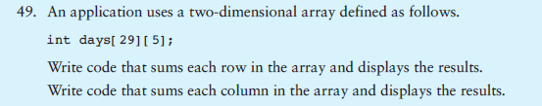
2)
#include "stdafx.h"
#include <ctime>
#include <cstdlib>
#include <iostream>
using namespace std;
int _tmain(int argc, _TCHAR* argv[])
{
int days[29][5];
srand(time(0));
for (int i=0; i<29; i++)
for (int j=0; j<5; j++)
days[i][j]=rand()%10000;
int rows=0, columns=0;
for (int i=0; i<29; i++) {
for (int j=0; j<5; j++)
columns +=days[i][j];
cout << "Sum of column " << i <<" is "<< columns << endl;
columns = 0;
}
for (int j=0; j<5; j++) {
for (int i=0; i<29; i++)
rows +=days[i][j];
cout << "Sum of row " << j <<" is "<< rows << endl;
rows = 0;
}
system("Pause");
return 0;
}

Slide 5

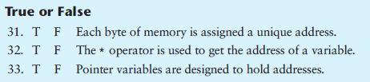
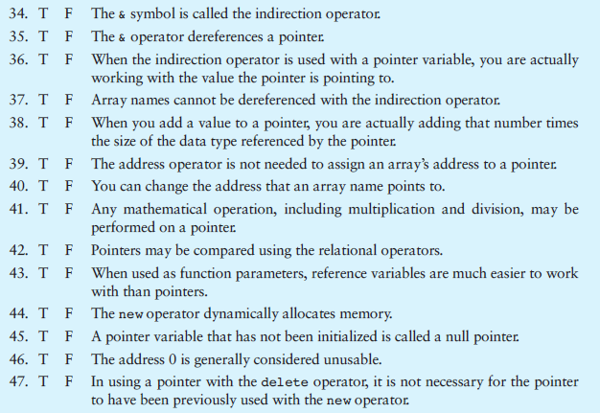
3)
4)
TRUE FALSE ANSWERS
31. TRUE
32. FALSE
33. TRUE
34. FALSE
35. FALSE
36. TRUE
37. FALSE
38. TRUE
39. TRUE
40. FALSE
41. FALSE
42. TRUE
43. TRUE
44. TRUE
45. FALSE
46. TRUE
47. FALSE

Slide 7
5) Implement three different pointer casts such as dynamic_cast, __try_cast, static_cast, reinterpret_cast, const_cast, C-Style Casts
as described in http://msdn.microsoft.com/en-us/library/aa712854(v=vs.71).aspx

Slide 8
Using references vs. pointers
string concatenate(string first, string second, string* middle)
{
stringstream ss;
ss << first << " " << *middle << " " << second;
string s = ss.str();
*middle = "passed by reference”;
return s;
}
int main()
{
string firstWord;
string secondWord;
string middleWord;
cout << "Please enter a word:" << endl;
cin >> firstWord;
cout << "Please enter a word to put in the middle:" << endl;
cin >> middleWord;
cout << "Please enter a third word:" << endl;
cin >> secondWord;
string phrase = concatenate(firstWord, secondWord, &middleWord);
cout << "Your final sentence is: " << phrase << endl;
cout << ”Modified: " << middleWord;
system("PAUSE");
}
string concatenate(const string& first, const string& second, const string& middle)
{
stringstream ss;
ss << first << " " << middle << " " << second;
string s = ss.str();
return s;
}
int main()
{
string firstWord;
string secondWord;
string middleWord;
cout << "Please enter a word:" << endl;
cin >> firstWord;
cout << "Please enter a word to put in the middle:" << endl;
cin >> middleWord;
cout << "Please enter a third word:" << endl;
cin >> secondWord;
string phrase = concatenate(firstWord, secondWord, middleWord);
cout << "Your final sentence is: " << phrase << endl;
system("PAUSE");
}

Slide 9
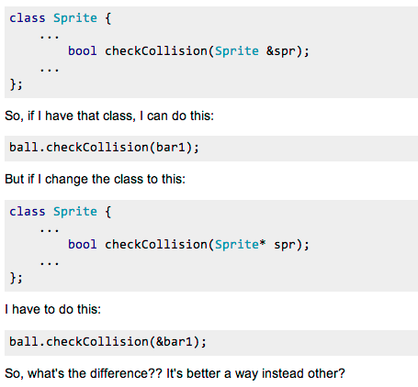

Slide 10
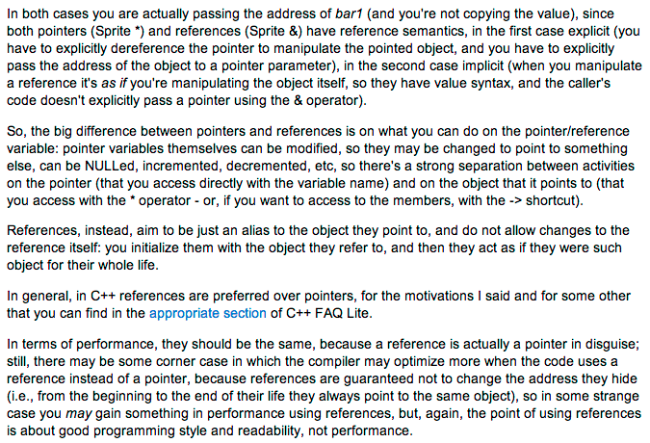

Slide 11
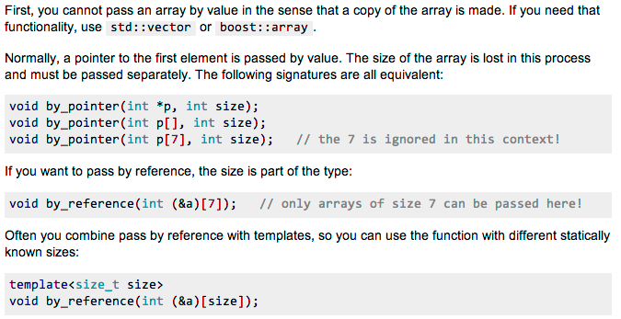
Arrays are passed as pointers, not by value

Slide 12
// prototype(s)
void mysort(int[], int, bool); // equivalent to void mysort(int*, int, bool);
void display_array(int[], int);
int main(int argc, char *argv[])
{
int testDesc[] = {6, 1, 2, 5, 3, 9};
int items = sizeof(testDesc)/sizeof(int);
display_array(testDesc, items);
// sort descending by reference
mysort(testDesc, items, true);
display_array(testDesc, items);
int testAsc[] = {1, 6, 10, 100, 200, 2, 5, 3, 9, 60};
items = sizeof(testAsc)/sizeof(int);
display_array(testAsc, items);
// sort ascending by reference
mysort(testAsc, items, false); display_array(testAsc, items);
return 0;
}
void mysort(int list[], int size, bool desc)
{
int match;
int temp;
for (int i = size - 1; i > 0; i--)
{
match = 0;
for (int j = 1; j <= i; j++) {
if (desc)
{
if ( list[j] < list[match] )
match = j;
}
else
{
if (list[j] > list[match])
match = j;
}
}
// swap values
temp = list[match];
list[match] = list[i];
list[i] = temp;
}
}

Slide 13


Slide 14
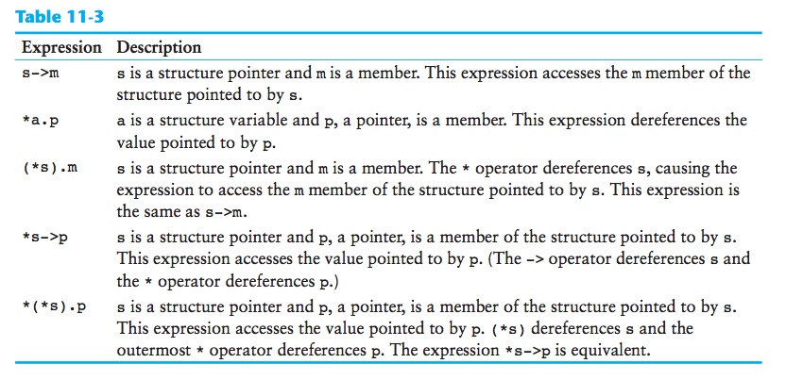

Slide 15
Quite a few topics in AI…
-genetic algorithms
-neural networks
-rules-based systems
-clustering algorithms
-ant algorithms
-fuzzy logic
-hidden Markov models
-simulated annealing
-intelligent agents
Applications include personalization engine, rules-based reasoning system, character trainer for game AI, Web-based news agent, genetic code optimizer, artificial life simulation, etc.
-classifier systems
-natural language processing
-particle swarm optimization
-A-Star pathfinding
-reinforcement learning

Slide 16
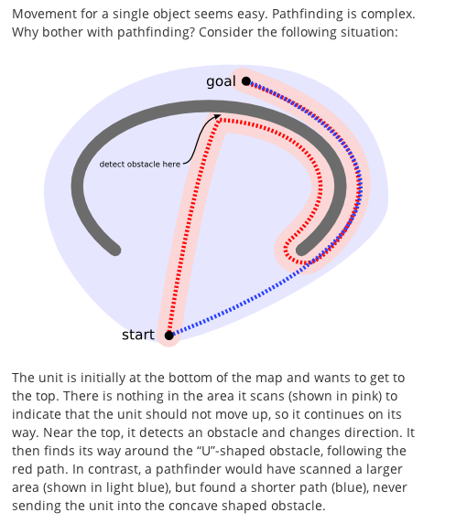
AI as pathfinding and planning

Slide 17
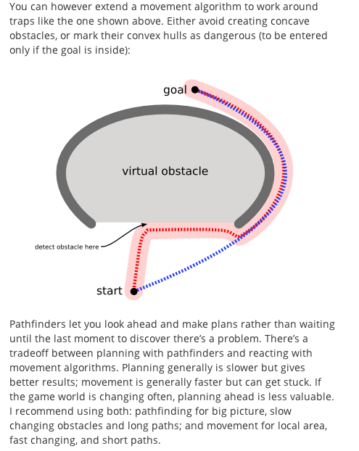

Slide 18
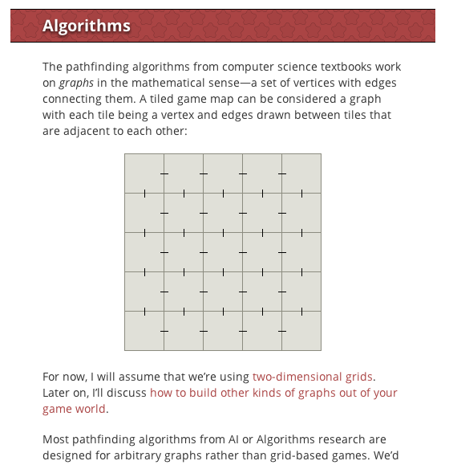

Slide 19
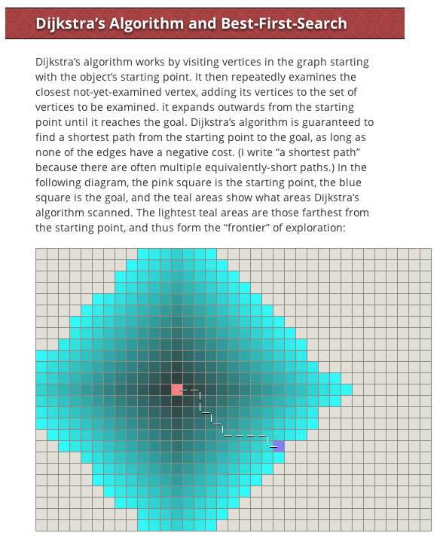

Slide 20
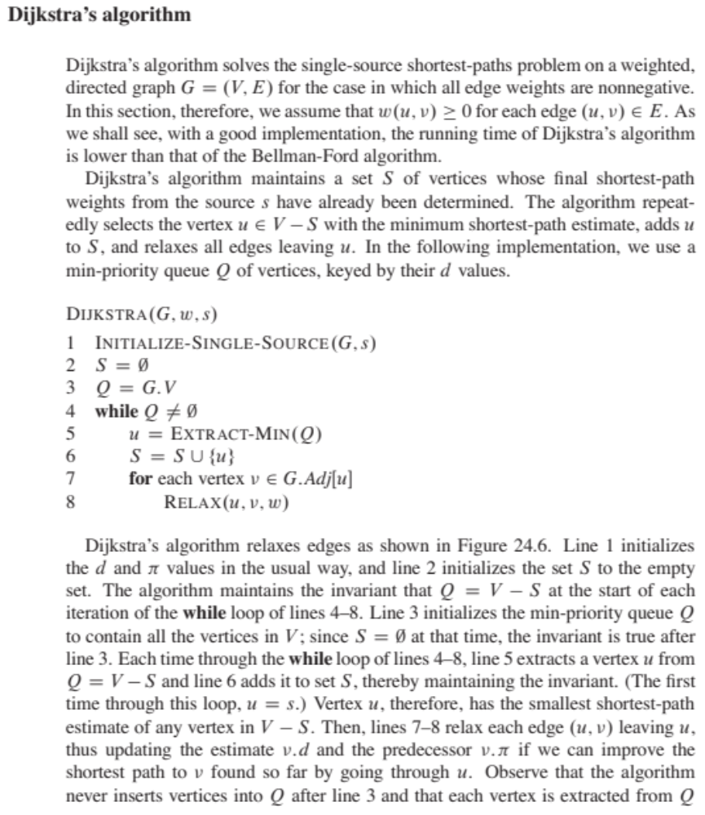

Slide 21
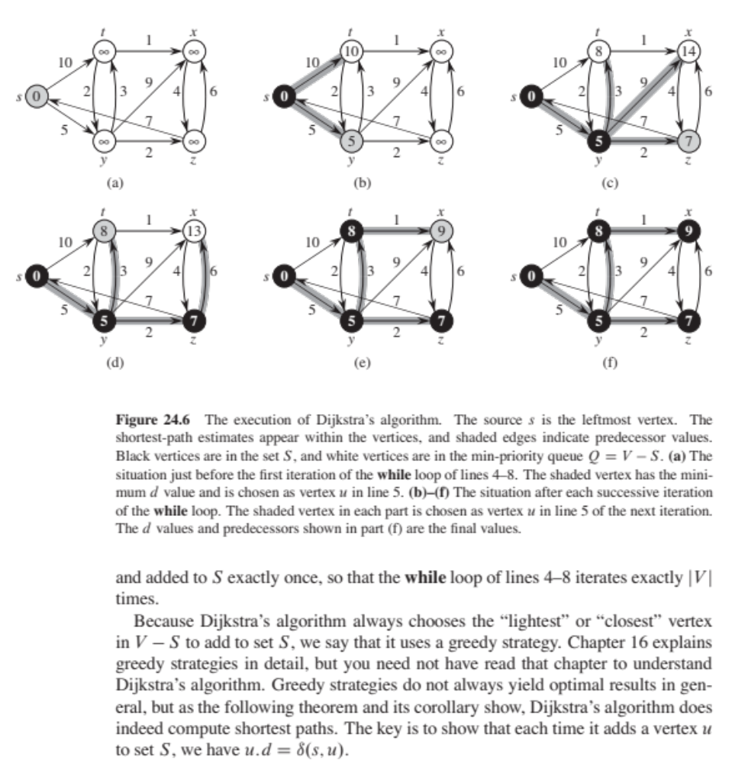

Slide 22
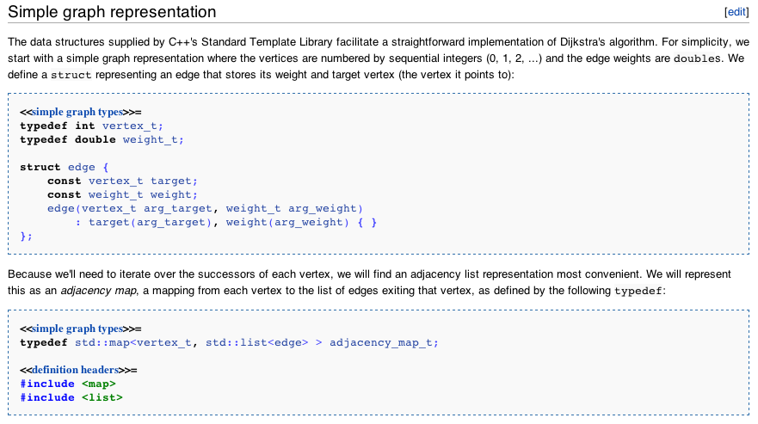

Slide 23
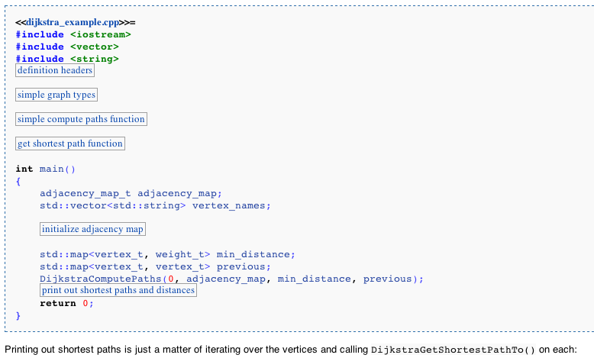

Slide 24
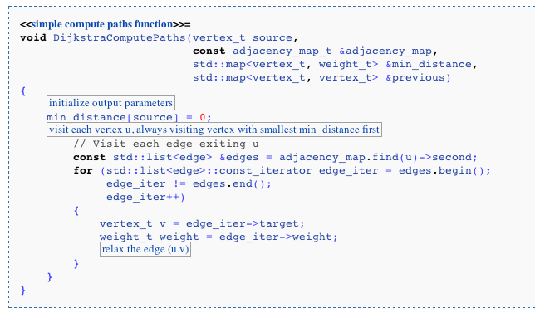

Slide 25
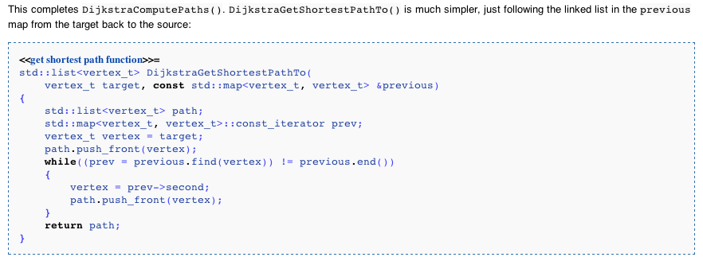

Slide 26
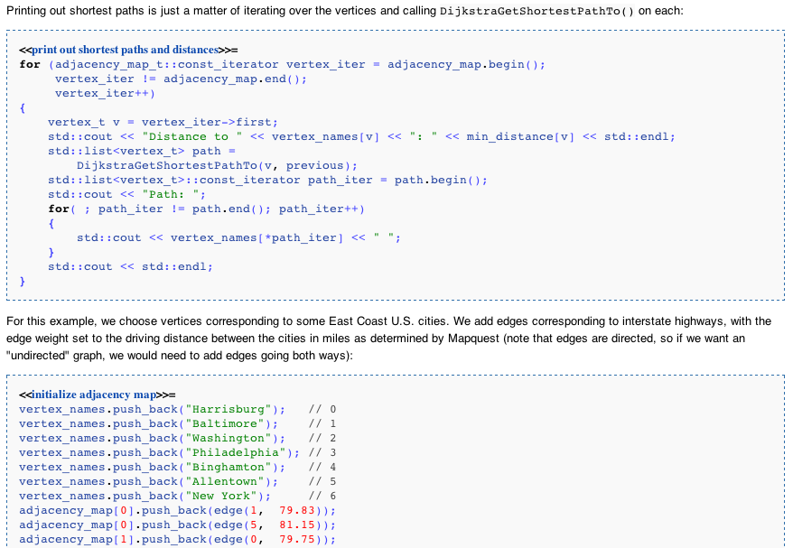

Slide 27
/* Retrieved from:
http://en.literateprograms.org/Dijkstra's_algorithm_(C_Plus_Plus)?oldid=17819 */
#include <iostream>
#include <vector>
#include <string>
#include <map>
#include <list>
#include <limits> // for numeric_limits
#include <set>
#include <utility> // for pair
typedef int vertex_t;
typedef double weight_t;
struct edge {
const vertex_t target;
const weight_t weight;
edge(vertex_t arg_target, weight_t arg_weight)
: target(arg_target), weight(arg_weight) { }
};
typedef std::map<vertex_t, std::list<edge> > adjacency_map_t;
void DijkstraComputePaths(vertex_t source,
const adjacency_map_t &adjacency_map,
std::map<vertex_t, weight_t> &min_distance,
std::map<vertex_t, vertex_t> &previous)
{
for (adjacency_map_t::const_iterator vertex_iter = adjacency_map.begin();
vertex_iter != adjacency_map.end();
vertex_iter++)
{
vertex_t v = vertex_iter->first;
min_distance[v] = std::numeric_limits< double >::infinity();
for (std::list<edge>::const_iterator edge_iter = vertex_iter->second.begin();
edge_iter != vertex_iter->second.end();
edge_iter++)
{
vertex_t v2 = edge_iter->target;
min_distance[v2] = std::numeric_limits< double >::infinity();
}
}
min_distance[source] = 0;
std::set< std::pair<weight_t, vertex_t> > vertex_queue;
vertex_queue.insert(std::make_pair(min_distance[source], source));
while (!vertex_queue.empty())
{
vertex_t u = vertex_queue.begin()->second;
vertex_queue.erase(vertex_queue.begin());
// Visit each edge exiting u
const std::list<edge> &edges = adjacency_map.find(u)->second;
for (std::list<edge>::const_iterator edge_iter = edges.begin();
edge_iter != edges.end();
edge_iter++)
{
vertex_t v = edge_iter->target;
weight_t weight = edge_iter->weight;
weight_t distance_through_u = min_distance[u] + weight;
if (distance_through_u < min_distance[v]) {
vertex_queue.erase(std::make_pair(min_distance[v], v));
min_distance[v] = distance_through_u;
previous[v] = u;
vertex_queue.insert(std::make_pair(min_distance[v], v));
}
}
}
}
std::list<vertex_t> DijkstraGetShortestPathTo(
vertex_t target, const std::map<vertex_t, vertex_t> &previous)
{
std::list<vertex_t> path;
std::map<vertex_t, vertex_t>::const_iterator prev;
vertex_t vertex = target;
path.push_front(vertex);
while((prev = previous.find(vertex)) != previous.end())
{
vertex = prev->second;
path.push_front(vertex);
}
return path;
}
int main()
{
adjacency_map_t adjacency_map;
std::vector<std::string> vertex_names;
vertex_names.push_back("Harrisburg"); // 0
vertex_names.push_back("Baltimore"); // 1
vertex_names.push_back("Washington"); // 2
vertex_names.push_back("Philadelphia"); // 3
vertex_names.push_back("Binghamton"); // 4
vertex_names.push_back("Allentown"); // 5
vertex_names.push_back("New York"); // 6
adjacency_map[0].push_back(edge(1, 79.83));
adjacency_map[0].push_back(edge(5, 81.15));
adjacency_map[1].push_back(edge(0, 79.75));
adjacency_map[1].push_back(edge(2, 39.42));
adjacency_map[1].push_back(edge(3, 103.00));
adjacency_map[2].push_back(edge(1, 38.65));
adjacency_map[3].push_back(edge(1, 102.53));
adjacency_map[3].push_back(edge(5, 61.44));
adjacency_map[3].push_back(edge(6, 96.79));
adjacency_map[4].push_back(edge(5, 133.04));
adjacency_map[5].push_back(edge(0, 81.77));
adjacency_map[5].push_back(edge(3, 62.05));
adjacency_map[5].push_back(edge(4, 134.47));
adjacency_map[5].push_back(edge(6, 91.63));
adjacency_map[6].push_back(edge(3, 97.24));
adjacency_map[6].push_back(edge(5, 87.94));
std::map<vertex_t, weight_t> min_distance;
std::map<vertex_t, vertex_t> previous;
DijkstraComputePaths(0, adjacency_map, min_distance, previous);
for (adjacency_map_t::const_iterator vertex_iter = adjacency_map.begin();
vertex_iter != adjacency_map.end();
vertex_iter++)
{
vertex_t v = vertex_iter->first;
std::cout << "Distance to " << vertex_names[v] << ": " << min_distance[v] << std::endl;
std::list<vertex_t> path =
DijkstraGetShortestPathTo(v, previous);
std::list<vertex_t>::const_iterator path_iter = path.begin();
std::cout << "Path: ";
for( ; path_iter != path.end(); path_iter++)
{
std::cout << vertex_names[*path_iter] << " ";
}
std::cout << std::endl;
}
return 0;
}
OUTPUT:
g++ dijkstra_example.cpp
dhcp-10-7-2-227:TurbineWarnerBros russell$ ./a.out
Distance to Harrisburg: 0
Path: Harrisburg
Distance to Baltimore: 79.83
Path: Harrisburg Baltimore
Distance to Washington: 119.25
Path: Harrisburg Baltimore Washington
Distance to Philadelphia: 143.2
Path: Harrisburg Allentown Philadelphia
Distance to Binghamton: 215.62
Path: Harrisburg Allentown Binghamton
Distance to Allentown: 81.15
Path: Harrisburg Allentown
Distance to New York: 172.78
Path: Harrisburg Allentown New York

Slide 28
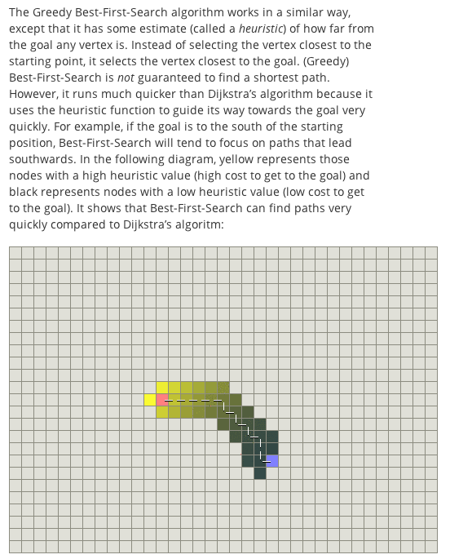

Slide 29
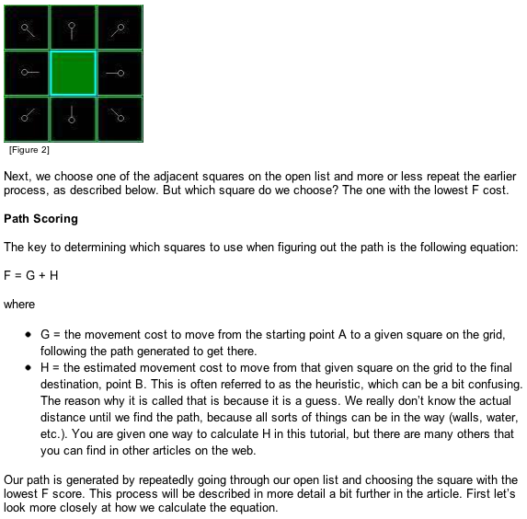
http://aitopics.org/topic/games-puzzles

Slide 30
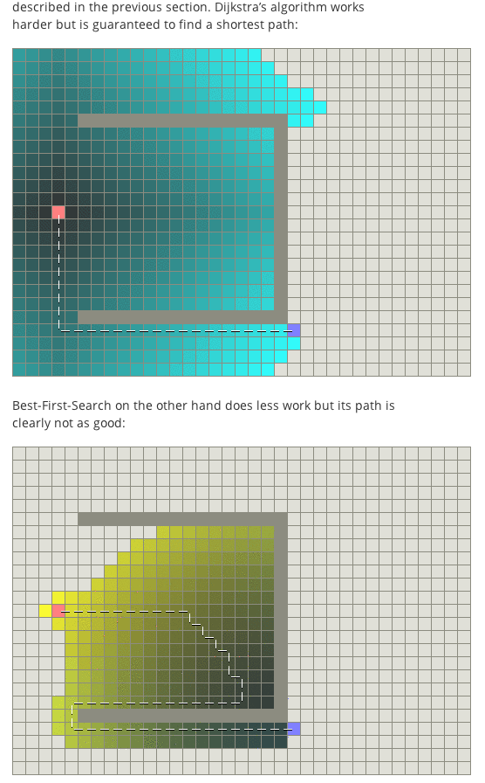

Slide 31
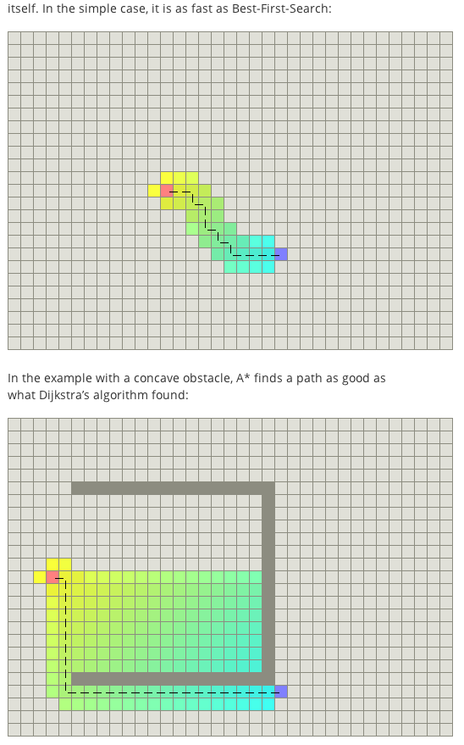

Slide 32
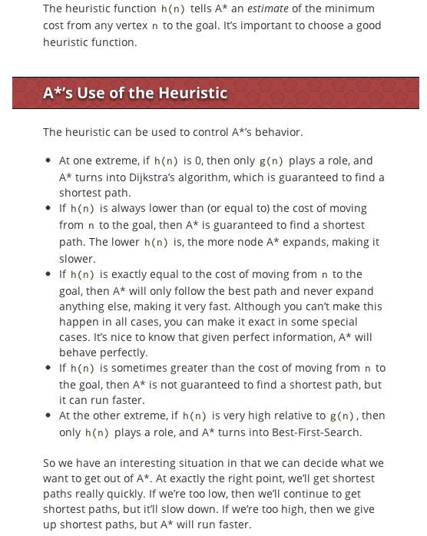

Slide 33
public void findBestPath() {
System.out.println("Calculating best path...");
Set<Square> adjacencies = elements[0][0].getAdjacencies();
for (Square adjacency : adjacencies) {
adjacency.setParent(elements[0][0]);
if (adjacency.isStart() == false) {
opened.add(adjacency);
}
}
while (opened.size() > 0) {
Square best = findBestPassThrough();
opened.remove(best);
closed.add(best);
if (best.isEnd()) {
System.out.println("Found Goal");
populateBestList(goal);
draw();
return;
} else {
Set<Square> neighbors = best.getAdjacencies();
for (Square neighbor : neighbors) {
if (opened.contains(neighbor)) {
Square tmpSquare = new Square(neighbor.getX(),
neighbor.getY(), this);
tmpSquare.setParent(best);
if (tmpSquare.getPassThrough(goal) >= neighbor
.getPassThrough(goal)) {
continue;
}}
if (closed.contains(neighbor)) {
Square tmpSquare = new Square(neighbor.getX(),
neighbor.getY(), this);
tmpSquare.setParent(best);
if (tmpSquare.getPassThrough(goal) >= neighbor
.getPassThrough(goal)) {
continue;
}
}
neighbor.setParent(best);
opened.remove(neighbor);
closed.remove(neighbor);
opened.add(0, neighbor);
} } }
System.out.println("No Path to goal");
}

Slide 34
Tips to avoid common game AI mistakes
“9) Using A* for everything
I run a web site which teaches A*, and yet when I come to write a pathfinding or other search program I don't always use A*, and when I do I never do A* on a fine mesh or grid. Why? Because it uses a lot of memory and processing power that is totally unneccesary.
Firstly if you're searching only small data sets, like an AI state graph, or a dozen or so path nodes in a room, you can use Dijkstra's algorithm, which is particularly effective when all the AI's in the room will path find to the same node, since the algorithm will fill out data for the whole network rather than just the start and end nodes. Sometimes even a breadthfirst search is enough.
In general you want the path finding data to be as high level as possible whilst still allowing movement to all possible gameplay areas.
One approach is hierarchical path finding, which really needs to work at engine level. If you divide your game world up into regions, buildings, floors and rooms, for example, an AI can path find at all those levels before finally pathfinding on a grid or mesh level inside the current room it is in.”

Slide 35
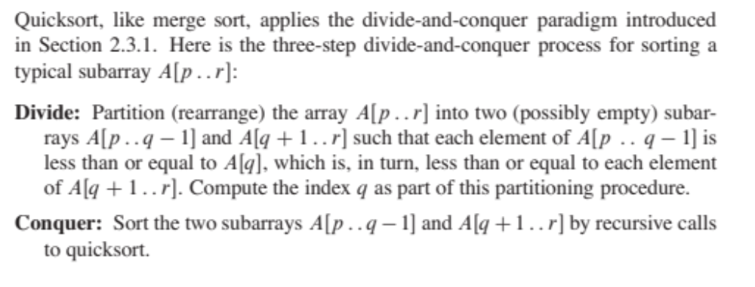
QuickSort O(n ln(n))

Slide 36
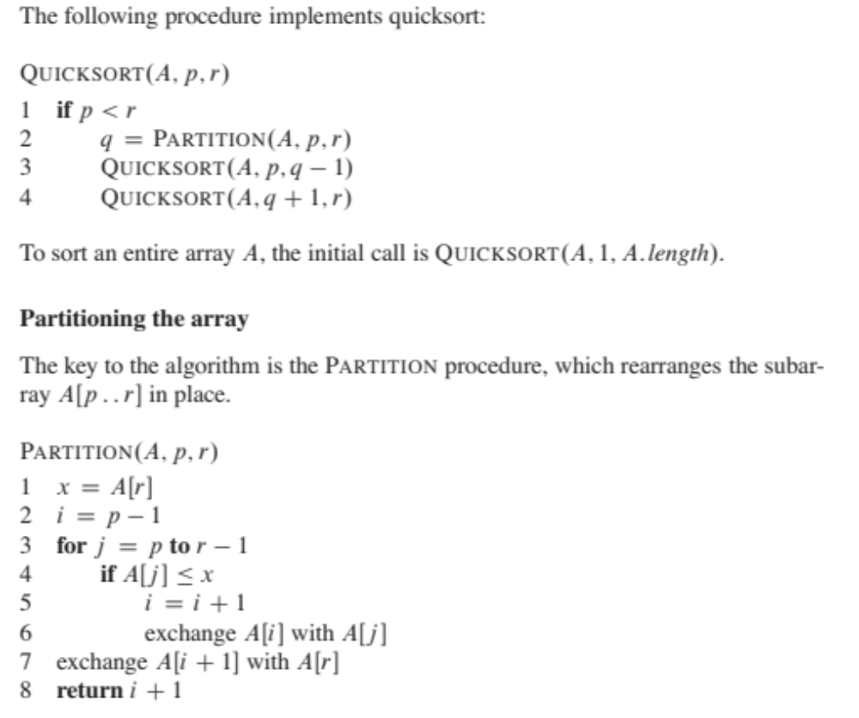

Slide 37

How to install boost & Ogre
Mac:
Run the following command:
sudo port install boost
Windows:
http://www.boost.org/users/download/

Slide 38
//=======================================================================
// Copyright 2001 Jeremy G. Siek, Andrew Lumsdaine, Lie-Quan Lee,
//
// Distributed under the Boost Software License, Version 1.0. (See
// accompanying file LICENSE_1_0.txt or copy at
// http://www.boost.org/LICENSE_1_0.txt)
//=======================================================================
#include <boost/config.hpp>
#include <iostream>
#include <fstream>
#include <boost/graph/graph_traits.hpp>
#include <boost/graph/adjacency_list.hpp>
#include <boost/graph/dijkstra_shortest_paths.hpp>
using namespace boost;
Int main(int, char *[])
{
typedef adjacency_list < listS, vecS, directedS,
no_property, property < edge_weight_t, int > > graph_t;
typedef graph_traits < graph_t >::vertex_descriptor vertex_descriptor;
typedef graph_traits < graph_t >::edge_descriptor edge_descriptor;
typedef std::pair<int, int> Edge;
const int num_nodes = 5;
enum nodes { A, B, C, D, E };
char name[] = "ABCDE";
Edge edge_array[] = { Edge(A, C), Edge(B, B), Edge(B, D), Edge(B, E),
Edge(C, B), Edge(C, D), Edge(D, E), Edge(E, A), Edge(E, B)
};
int weights[] = { 1, 2, 1, 2, 7, 3, 1, 1, 1 };
int num_arcs = sizeof(edge_array) / sizeof(Edge);
#if defined(BOOST_MSVC) && BOOST_MSVC <= 1300
graph_t g(num_nodes);
property_map<graph_t, edge_weight_t>::type weightmap = get(edge_weight, g);
for (std::size_t j = 0; j < num_arcs; ++j) {
edge_descriptor e; bool inserted;
tie(e, inserted) = add_edge(edge_array[j].first, edge_array[j].second, g);
weightmap[e] = weights[j];
}
#else
graph_t g(edge_array, edge_array + num_arcs, weights, num_nodes);
property_map<graph_t, edge_weight_t>::type weightmap = get(edge_weight, g);
#endif
std::vector<vertex_descriptor> p(num_vertices(g));
std::vector<int> d(num_vertices(g));
vertex_descriptor s = vertex(A, g);
#if defined(BOOST_MSVC) && BOOST_MSVC <= 1300
// VC++ has trouble with the named parameters mechanism
property_map<graph_t, vertex_index_t>::type indexmap = get(vertex_index, g);
dijkstra_shortest_paths(g, s, &p[0], &d[0], weightmap, indexmap,
std::less<int>(), closed_plus<int>(),
(std::numeric_limits<int>::max)(), 0,
default_dijkstra_visitor());
#else
dijkstra_shortest_paths(g, s, predecessor_map(&p[0]).distance_map(&d[0]));
#endif
std::cout << "distances and parents:" << std::endl;
graph_traits < graph_t >::vertex_iterator vi, vend;
for (tie(vi, vend) = vertices(g); vi != vend; ++vi) {
std::cout << "distance(" << name[*vi] << ") = " << d[*vi] << ", ";
std::cout << "parent(" << name[*vi] << ") = " << name[p[*vi]] << std::
endl;
}
std::cout << std::endl;
std::ofstream dot_file("figs/dijkstra-eg.dot");
dot_file << "digraph D {\n"
<< " rankdir=LR\n"
<< " size=\"4,3\"\n"
<< " ratio=\"fill\"\n"
<< " edge[style=\"bold\"]\n" << " node[shape=\"circle\"]\n";
graph_traits < graph_t >::edge_iterator ei, ei_end;
for (tie(ei, ei_end) = edges(g); ei != ei_end; ++ei) {
graph_traits < graph_t >::edge_descriptor e = *ei;
graph_traits < graph_t >::vertex_descriptor
u = source(e, g), v = target(e, g);
dot_file << name[u] << " -> " << name[v]
<< "[label=\"" << get(weightmap, e) << "\"";
if (p[v] == u)
dot_file << ", color=\"black\"";
else
dot_file << ", color=\"grey\"";
dot_file << "]";
}
dot_file << "}";
return EXIT_SUCCESS;
}

Slide 39
//=======================================================================
// Copyright 2001 Jeremy G. Siek, Andrew Lumsdaine, Lie-Quan Lee,
//
// Distributed under the Boost Software License, Version 1.0. (See
// accompanying file LICENSE_1_0.txt or copy at
// http://www.boost.org/LICENSE_1_0.txt)
//=======================================================================
#include <boost/config.hpp>
#include <iostream>
#include <fstream>
#include <boost/graph/graph_traits.hpp>
#include <boost/graph/adjacency_list.hpp>
#include <boost/graph/dijkstra_shortest_paths.hpp>
using namespace boost;
int
main(int, char *[])
{
typedef adjacency_list < listS, vecS, directedS,
no_property, property < edge_weight_t, int > > graph_t;
typedef graph_traits < graph_t >::vertex_descriptor vertex_descriptor;
typedef graph_traits < graph_t >::edge_descriptor edge_descriptor;
typedef std::pair<int, int> Edge;
const int num_nodes = 5;
enum nodes { A, B, C, D, E };
char name[] = "ABCDE";
Edge edge_array[] = { Edge(A, C), Edge(B, B), Edge(B, D), Edge(B, E),
Edge(C, B), Edge(C, D), Edge(D, E), Edge(E, A), Edge(E, B)
};
int weights[] = { 1, 2, 1, 2, 7, 3, 1, 1, 1 };
int num_arcs = sizeof(edge_array) / sizeof(Edge);
#if defined(BOOST_MSVC) && BOOST_MSVC <= 1300
graph_t g(num_nodes);
property_map<graph_t, edge_weight_t>::type weightmap = get(edge_weight, g);
for (std::size_t j = 0; j < num_arcs; ++j) {
edge_descriptor e; bool inserted;
tie(e, inserted) = add_edge(edge_array[j].first, edge_array[j].second, g);
weightmap[e] = weights[j];
}
#else
graph_t g(edge_array, edge_array + num_arcs, weights, num_nodes);
property_map<graph_t, edge_weight_t>::type weightmap = get(edge_weight, g);
#endif
std::vector<vertex_descriptor> p(num_vertices(g));
std::vector<int> d(num_vertices(g));
vertex_descriptor s = vertex(A, g);
#if defined(BOOST_MSVC) && BOOST_MSVC <= 1300
// VC++ has trouble with the named parameters mechanism
property_map<graph_t, vertex_index_t>::type indexmap = get(vertex_index, g);
dijkstra_shortest_paths(g, s, &p[0], &d[0], weightmap, indexmap,
std::less<int>(), closed_plus<int>(),
(std::numeric_limits<int>::max)(), 0,
default_dijkstra_visitor());
#else
dijkstra_shortest_paths(g, s, predecessor_map(&p[0]).distance_map(&d[0]));
#endif
std::cout << "distances and parents:" << std::endl;
graph_traits < graph_t >::vertex_iterator vi, vend;
for (tie(vi, vend) = vertices(g); vi != vend; ++vi) {
std::cout << "distance(" << name[*vi] << ") = " << d[*vi] << ", ";
std::cout << "parent(" << name[*vi] << ") = " << name[p[*vi]] << std::
endl;
}
std::cout << std::endl;
std::ofstream dot_file("figs/dijkstra-eg.dot");
dot_file << "digraph D {\n"
<< " rankdir=LR\n"
<< " size=\"4,3\"\n"
<< " ratio=\"fill\"\n"
<< " edge[style=\"bold\"]\n" << " node[shape=\"circle\"]\n";
graph_traits < graph_t >::edge_iterator ei, ei_end;
for (tie(ei, ei_end) = edges(g); ei != ei_end; ++ei) {
graph_traits < graph_t >::edge_descriptor e = *ei;
graph_traits < graph_t >::vertex_descriptor
u = source(e, g), v = target(e, g);
dot_file << name[u] << " -> " << name[v]
<< "[label=\"" << get(weightmap, e) << "\"";
if (p[v] == u)
dot_file << ", color=\"black\"";
else
dot_file << ", color=\"grey\"";
dot_file << "]";
}
dot_file << "}";
return EXIT_SUCCESS;
}

Slide 40
Simple Tic-Tac-Toe “AI”
Basic Tic-Tac-Toe strategy for the computer:
If there's a move that allows the computer to win this turn, the computer should choose that move.
If there's a move that allows the human to win next turn, the computer should choose that move.
Otherwise, the computer should choose the best empty square as its move. The best square is the center. The next best squares are the corners. And the next best squares are the corners. And the next best squares are the rest.

Slide 41
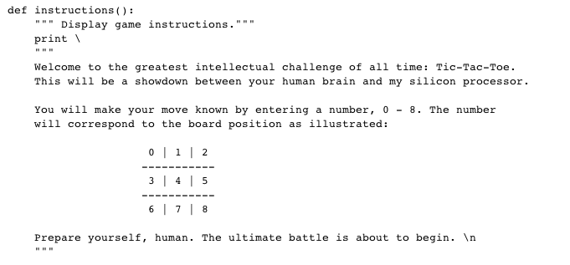

Slide 42
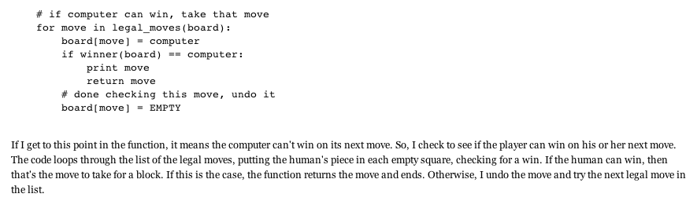
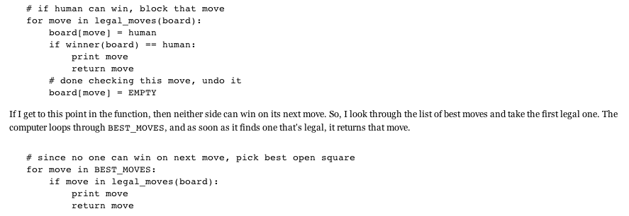

Slide 43
ENDE

